Slide 1
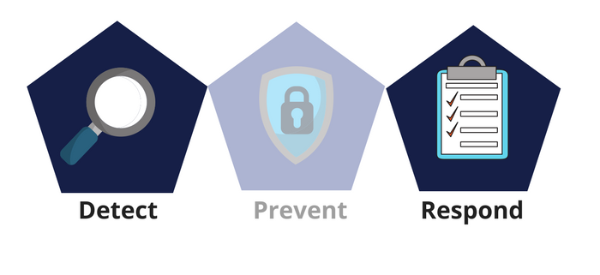



Network Security
Class X
lab 28

Slide 2

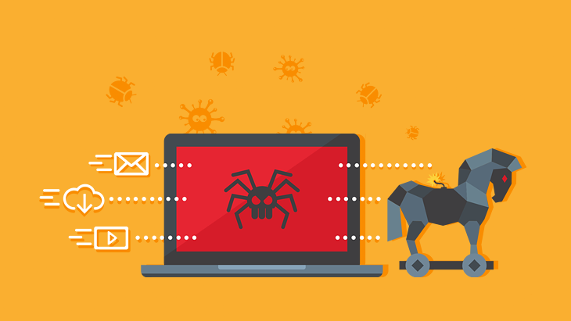
Trojans
Trojans are non-replication
programs; they don’t
reproduce their own codes
by attaching themselves to
other executable codes

Slide 3
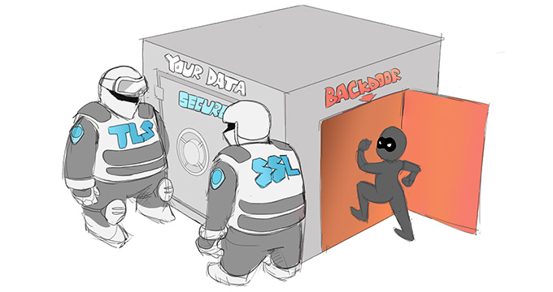
Malicious Functions of Trojan
creates backdoor to a system

Slide 4

Malicious Functions of Trojan
steal all your financial data like bank accounts, transaction details

Slide 5
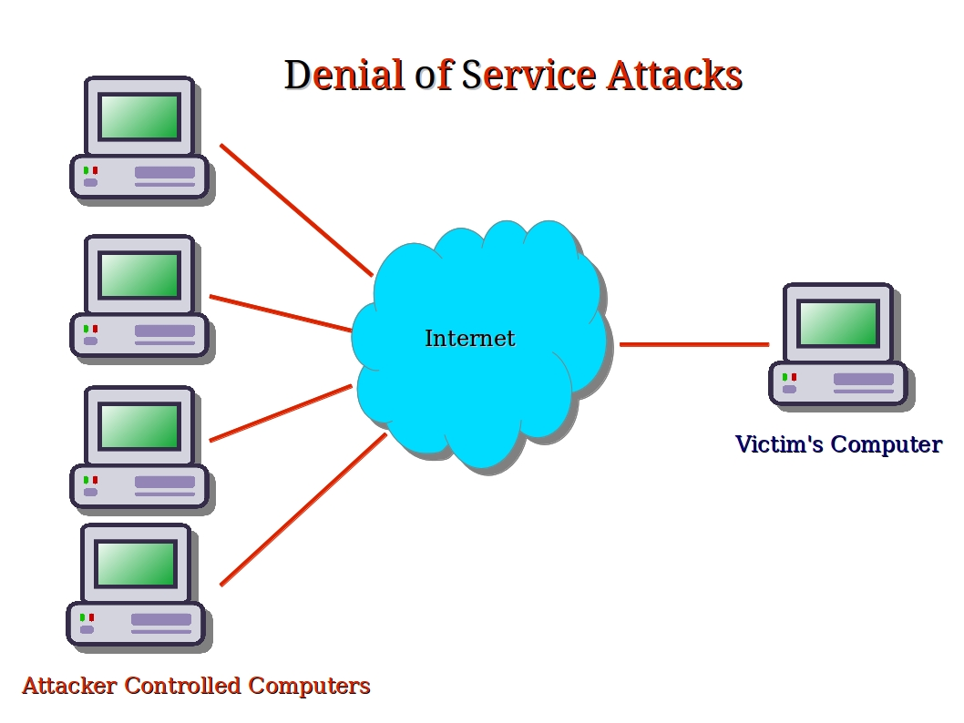
Malicious Functions of Trojan
DOS Attack

Slide 6
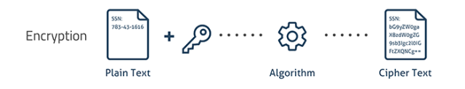
Malicious Functions of Trojan
Trojans can encrypt all of your files

Slide 7
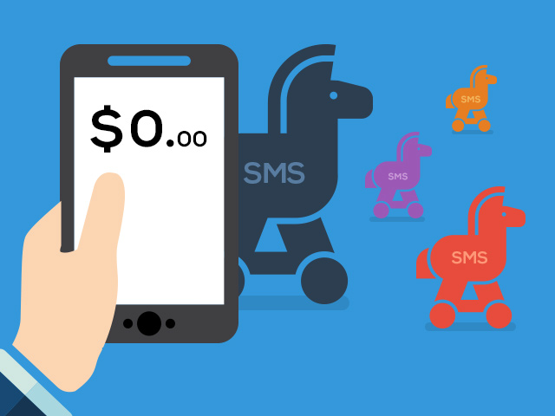
Malicious Functions of Trojan
Trojans can
encrypt all
of your files

Slide 8

Malicious Functions of Trojan
Trojans can use your phones to send SMS to third parties

Slide 9
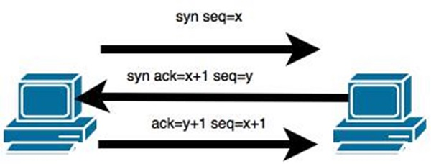
TCP/IP Hijacking
when an authorized user gains access to a genuine network connection of another user

Slide 10
Thank You

